Slide 1
Tic Tac Toe Project

Slide 2
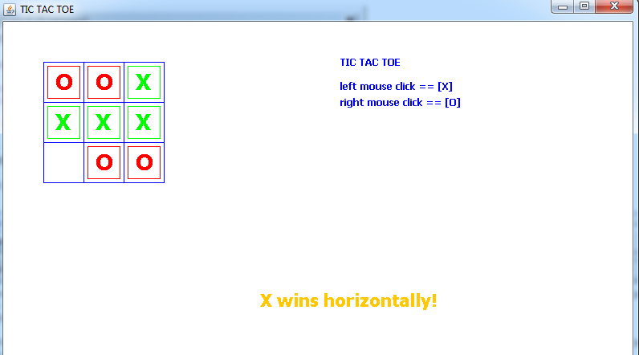

Slide 3
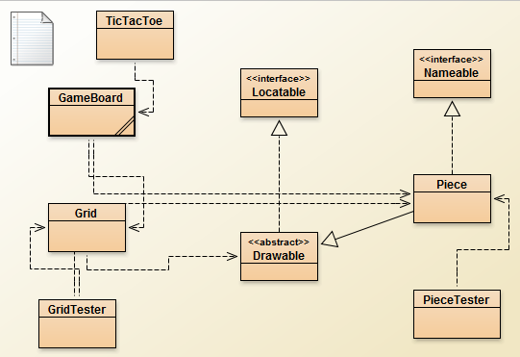

Uses Relationship
(Object is made)
Inheritance Relationship
(implements or extends)

Slide 4
Part 1

Slide 5
Part 2

Slide 6
Part 3

